Slide 1
Introduction to OpenAI Agents SDK
Prepared by: Muhammad Abdul Qayum
National Textile University
Faisalabad

Slide 2
contents
Design principles of OpenAI Agents SDK, including minimal abstraction and frameworks for multi-agent orchestration—Pythonic, flexible, and extensible
Core primitives that make up the SDK, with detailed examples of each primitive and how they are used
GitHub repository at https://github.com/PacktPublishing/Building-Agents-with-OpenAI-Agents-SDK.

Slide 3
Design features of OpenAI Agents SDK
balance between simplicity and flexibility, making it easy for beginners to use while still powerful enough for advanced developer

Slide 4
Framework for building AI agents
OpenAI Agents SDK works similarly to web frameworks like Django or Ruby on Rails.
It abstracts the low-level complexities of AI agent development — so you don’t have to “wrestle the wires” yourself.
Developers can focus on high-impact logic instead of infrastructure
Enables rapid agent creation and deployment with minimal setup — almost like using a pre-built kitchen instead of building one from scratch.
Accelerating development productivity.

Slide 5
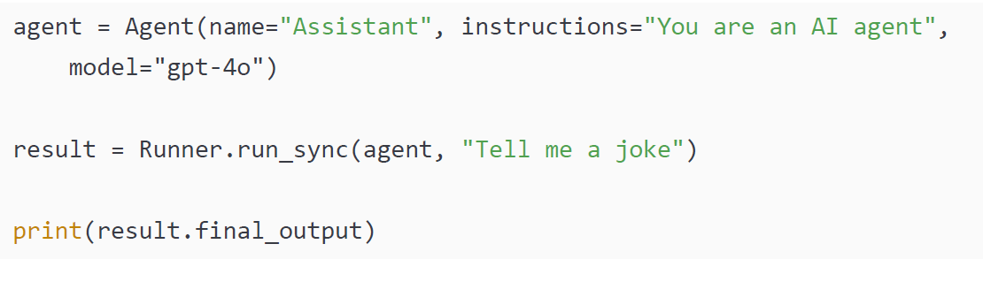
Framework for building AI agents
With the SDK, we can create an agent with a few lines of Python code:
Notes:
control logic framework that enables the agent to think iteratively is already embedded within the agent itself as a direct result of the framework. We then run the agent on a user query and print the output from the model.
Without the SDK, this would notably take thousands of lines of code to orchestrate, not to mention the additional thousands of lines of code to create a tracing and logging system that you get automatically with OpenAI Agents SDK.
OpenAI Agents SDK is engineered to address the inherent challenges in constructing LLM-driven processes that require more than just text generation. These challenges include enabling models to reason through multi-step problems, interact with external data sources and APIs (tool use), and coordinate actions among multiple AI entities.
Multi-agent orchestration
As a subset, this framework also enables developers to build multi-agent solutions. In fact, this was the original purpose of the framework’s predecessor, Swarm (the idea being you can originate a series of agents in a swarm-like fashion to complete a task). The idea here is that for specific tasks, you can’t have one agent do everything. Instead, you have a team of agents, each specialized in a particular task, that hand off the delegation to each other when necessary.
Note
At this point, we are introducing code as a way to understand the simplicity and ease of use of implementing the SDK. To actually run the code would require installing and importing the necessary libraries, which we will go through in detail in the next chapter.
Without the SDK, this would notably take thousands of lines of code to orchestrate, not to mention the additional thousands of lines of code to create a tracing and logging system that you get automatically with OpenAI Agents SDK.
OpenAI Agents SDK is engineered to address the inherent challenges in constructing LLM-driven processes that require more than just text generation. These challenges include enabling models to reason through multi-step problems, interact with external data sources and APIs (tool use), and coordinate actions among multiple AI entities.

Slide 6
Multi-agent orchestration
The framework also supports building multi-agent systems, teamwork makes the AI dream work.
Ideal for problems where one agent can’t (or shouldn’t) do everything —
Tasks can be divided among specialized agents,
These agents handoff tasks to one another when needed, forming a smooth chain of delegation.
Code examples are introduced here only for conceptual understanding; running them requires setup that will be covered in the next chapter.

Slide 7
Multi-agent orchestration
Figure 2.1: A customer support workflow

Slide 8
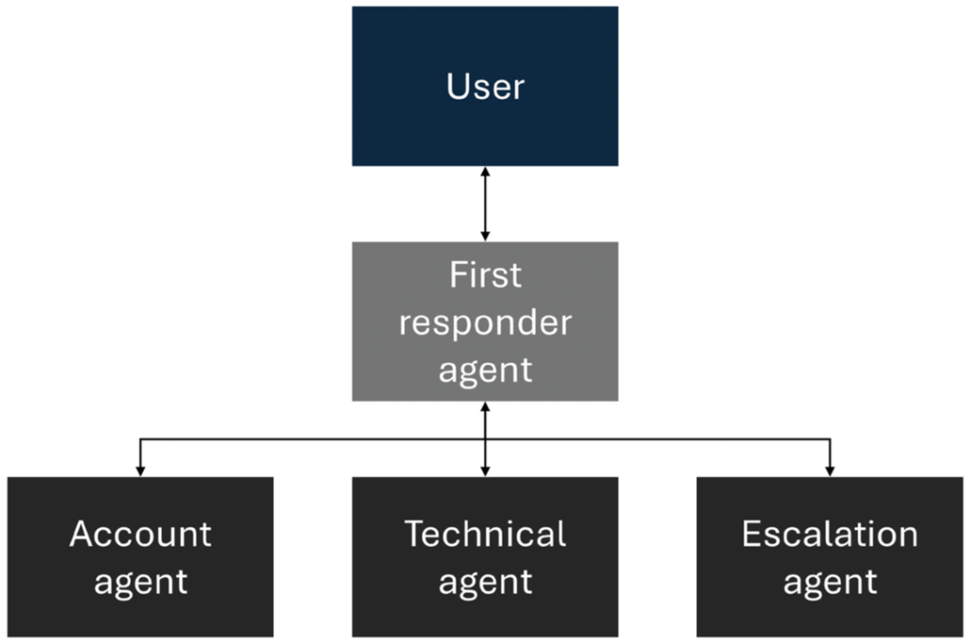
Multi-agent orchestration
Let’s break down and discuss the agentic workflow:
First responder agent: Answers the calls, understands the issue, performs simple FAQ requests, and hands off to other agents as needed
Account agent: Can look up customer orders and status
Technical agent: Can fix user authentication bugs and set up new connection lines for the customer
Escalation agent: Loops in a human as a last possible resort
(done with a primitive called handoffs).

Slide 9
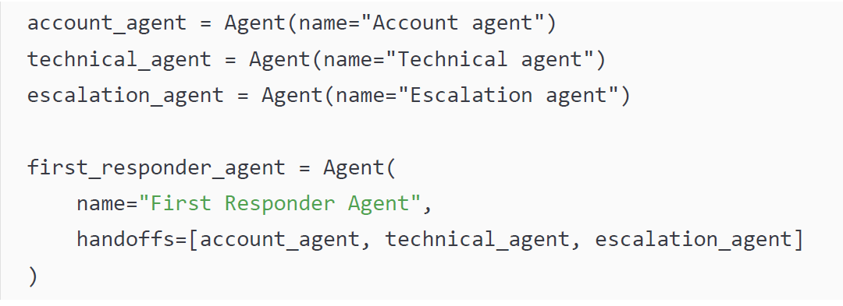
Multi-agent orchestration
Notes:
Each agent focuses on its domain, yet to the end user, the experience feels like a single, coherent conversation. All the context-passing, role-switching, and error-handling happen inside the SDK’s orchestration layer (done with a primitive called handoffs). You configure handoff routes once and let the framework do the choreography. This can be done with a few lines of code:

Slide 10
Minimal abstraction
OpenAI Agents SDK follows the philosophy: “fewer primitives = easier learning.”
Instead of many complex classes, the SDK offers a small, memorable set of primitives.
Core primitives include: Agents, Runner, Tools, Handoffs, Guardrails, Tracing (your new six AI superheroes).
If you understand these primitives, you’ve mastered 80% of the framework.
No hidden meta-language, no magical black-box runtime — just plain Python.

Slide 11
Minimal abstraction
Developers only need to decorate functions with @function_tool and run.
This results in fast onboarding — you can read the docs at lunch and build a prototype before tea time.
The SDK is lightweight, not a massive “everything-included” framework.
Unlike LangChain, it does not provide hundreds of built-in integrations (e.g., memory stores, document loaders).
Developers may need to build some integrations manually, giving more flexibility… and sometimes more coffee breaks.
Notes:
OpenAI Agents SDK keeps things intentionally simple by providing just a handful of core primitives. Mastering these gives you most of the framework's power without needing to learn complex new abstractions. It's lightweight, transparent, and easy to adopt—using plain Python and simple decorators for tools. However, this simplicity means developers must build some integrations themselves, unlike larger frameworks that come with everything prepackaged

Slide 12
Pythonic, extensible, and open sourced
In OpenAI Agents SDK, an agent is simply a Python object—nothing mysterious, no secret class hierarchy.
A tool is just a normal Python function, enhanced with a special decorator.
You orchestrate agents and tools using ordinary Python constructs (loops, conditions, classes—your daily bread).
This design makes the SDK extremely friendly for Python developers, reducing the learning curve.
The philosophy is similar to minimalist, beloved frameworks like Flask and Pydantic—simple, elegant, and predictable.
Notes:
penAI Agents SDK keeps things simple by treating agents as basic Python objects and tools as regular functions with decorators. You use everyday Python to connect everything, much like working with lightweight frameworks such as Flask or Pydantic. This simplicity makes the SDK approachable, powerful, and ideal for rapid development.

Slide 13
Pythonic, extensible, and open sourced
OpenAI Agents SDK is “ready to deploy” with default constructs but is also deliberately extensible. Any particular construct can be hot-swapped with your own component:
The agent’s model is fully interchangeable—any LLM, including on-premise models like LLAMA, can be used as long as it follows the Chat Completions standard. This makes the OpenAI Agents SDK completely model-agnostic.
The tools in this framework are just Python functions with added decorators, meaning they can easily be swapped at any time for another Python function or a hosted API call, including connecting to MCP servers.
The tracing is, by default, sent to the Traces dashboard within OpenAI but can be hooked up to any telemetry tool such as Azure Monitor Logs or DataDog.
Notes:
Technically, even the agent-execution loop is modular. The high-level runner handles retries, step limits, and concurrent calls, but advanced users can bypass it and drive lower-level primitives directly inside an existing event loop or task queue.
For example, rather than calling Runner.run_sync(agent, input), an advanced user can manually step through the agent’s execution logic using the agent.run_step(...) method or control the loop using agent.get_initial_state() and agent.step(...). This is particularly useful in environments where you need to interleave agent execution with other async operations, such as within a FastAPI route, allowing for full control over timing, concurrency, or resource management.
Finally, the SDK is open sourced, which means this framework benefits from complete transparency and an ever-growing list of developers who are continually improving the framework and making it more resilient.
Overall, OpenAI Agents SDK provides a streamlined, Pythonic framework specifically designed to simplify and accelerate the creation and orchestration of sophisticated AI agents. By offering minimal yet powerful abstractions (agents, runners, tools, handoffs, guardrails, and tracing), the SDK empowers developers to quickly build complex, multi-agent solutions without wrestling with excessive boilerplate or hidden configurations. Its extensibility and compatibility with existing Python constructs enable both rapid deployment and deep customization when creating AI agents.

Slide 14
Core primitives

Slide 15
Core primitives
OpenAI Agents SDK provides a small set of core primitives (foundational building blocks) for creating agent-based applications.
These primitives define what an agent knows (state), what it can do (tools), and how it thinks or decides (policy).
Instead of building every part of an AI agent from scratch, developers assemble these primitives like LEGO bricks to create a complete agent.
The SDK focuses on simplicity, offering minimal but powerful components that can be combined in many ways.
Future versions may include prebuilt patterns or templates, similar to LEGO instruction manuals, but the core primitives remain the essential building blocks.

Slide 16
Agent
Name: The name of the agent, typically only used for identification purposes
Instructions: These are identical to the system prompt that we discussed in the previous chapter; they provide the guidelines to the LLM on its role, objectives, behaviors, and personas
Model: The underlying LLM that powers the agent’s intelligence
Tools: A list of tools that the agent can call to get answers
Handoffs: A list of other agents to whom the agent can delegate tasks
Notes:
The agent primitive is the most fundamental concept of OpenAI Agents SDK. It essentially serves as a highly configurable wrapper around an LLM to make it “agentic” (i.e., providing it with a persona or system instructions, a tooling interface, and other settings necessary for it to autonomously make decisions and pursue a goal). When an agent is instantiated with the agent primitive, it can have the following configuration:

Slide 17
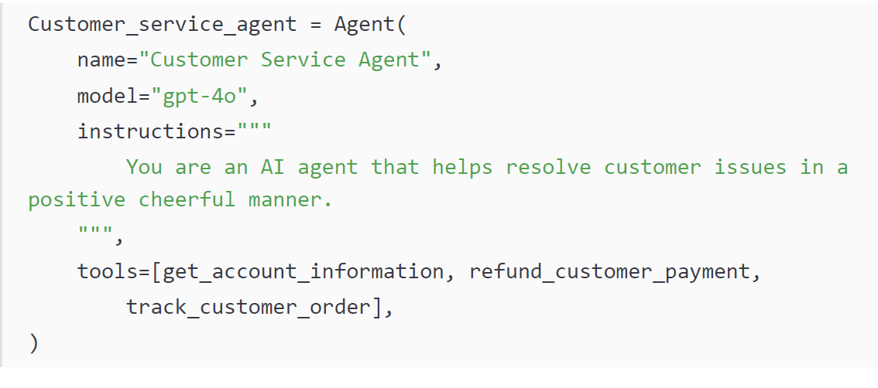
Agent
The Agent class can also take in other useful parameters such as guardrails, output type, and many more. These will be covered in subsequent chapters
Notes:
Unsurprisingly, most of these components match the anatomy of an AI agent that we discussed in the previous chapter. This configurability is what enables developers to quickly spin up specialized agents, tailored to a specific role or task within a larger application.
This agent can either respond with natural language or call one of the tools it’s been given. It’s worth mentioning that this SDK provides a single Agent class, unlike some frameworks that have different classes for each agent type. Here, the agent behavior simply depends on the preceding configurations, nothing else.

Slide 18
Runner
This primitive is the engine behind an agent.
A key element in a successful agentic application is its ability to iteratively and autonomously solve a problem (i.e., it can make decisions and vary based on further inputs it receives to achieve a goal).
This agent loop functionality is baked into this primitive
The Runner (sometimes called the Agent Loop) is the cyclical process of interacting with the LLM, managing tool calls, determining what it should do next, and repeating the process.

Slide 19
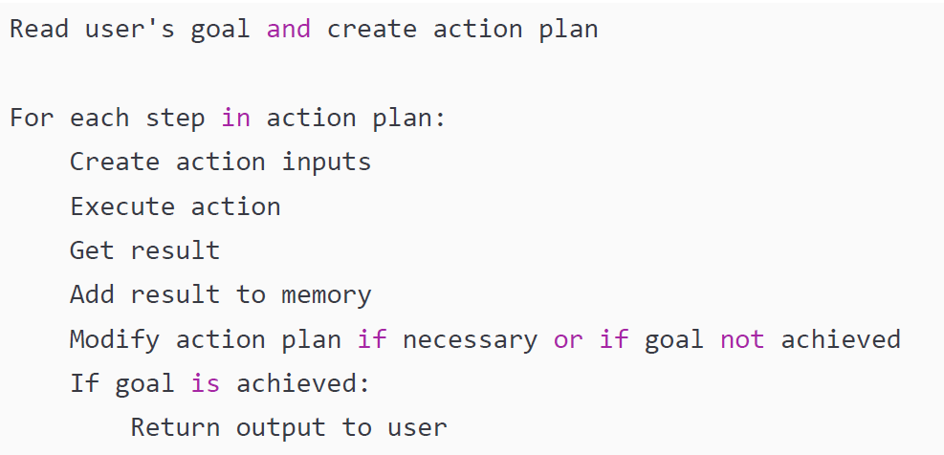
Runner

Slide 20
Runner
The agent loop automates the core reasoning logic, reducing developer effort.
It hides the low-level orchestration of LLM calls, tool execution, and step-by-step control flow.
Developers can focus on high-level agent behavior, such as instructions and tools, instead of execution mechanics.
Previously, building agents required developers to manually capture the model’s reasoning (chain of thought) and implement the full loop themselves.
The SDK removes this complexity, making agent development much simpler and more reliable.
Notes:
Runner.run() has a useful argument called max_turns that caps how many cycles the agent may take. By bounding the loop, max_turns acts as a safety valve against endless spins caused by a bad configuration or an unsolvable task. We will go through this in detail in subsequent chapters

Slide 21
Tools
The tool primitive is a core concept and highly praised for its simplicity and elegance.
Any Python function can be converted into a tool using a special decorator.
The decorator allows the agent’s LLM to understand the tool automatically via its name, docstring, and arguments.
When invoked, the LLM generates the necessary arguments/schema to call the tool correctly.
Example: A function returning the status of an order can be made into a tool; the decorator parses its docstring and arguments and instructs the LLM on usage.
This enables the agent to know what tools are available, their capabilities, and required inputs without manual configuration.

Slide 22
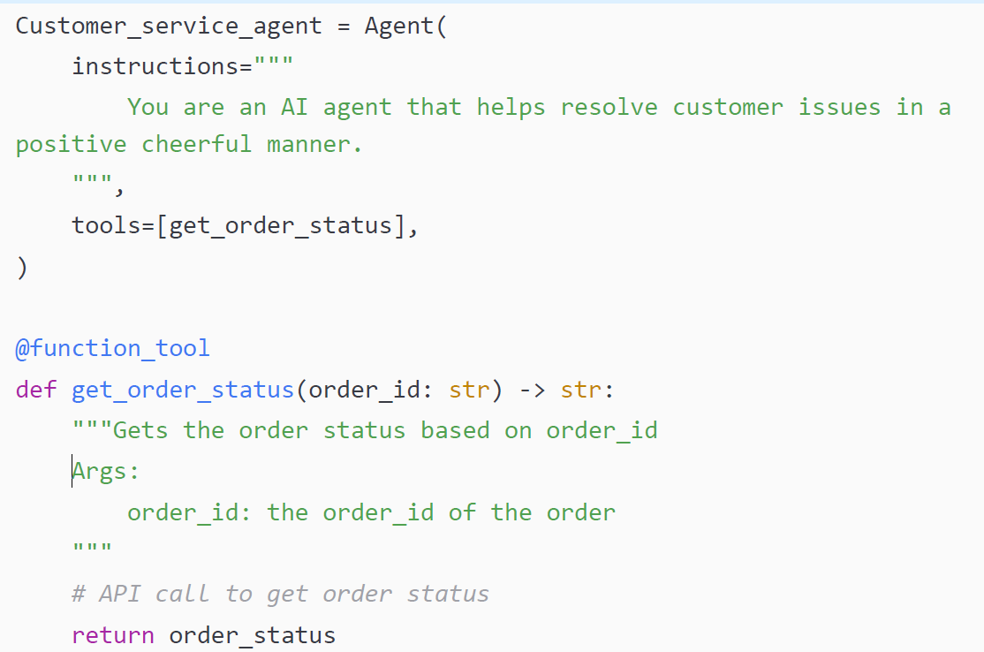
Tools
Here is the code to create a tool:

Slide 23
Tools
Note that OpenAI Agents SDK also enables developers to instantiate other types of tools in addition to user-defined functions—hosted tools and agents as tools:
Hosted tools: These are built-in tools specifically provided by and hosted in OpenAI. They include common tools that you may want your agent to have, such as the ability to search the web, search through files, generate an image, and so on. They also include the ability to connect to a local computer’s shell/terminal or functionality via a hosted Model Context Protocol (MCP) server.
Agents as tools: These are agents that you have previously instantiated that are then converted into tools. This, however, is rare in practice as calling agents are typically achieved through handoffs where they are more like context passing.
Notes:
uhn·stan·shee·ayt
In Python, instantiation refers to the process of creating an instance (or object) of a class

Slide 24
Handoff
The handoff primitive manages how agents delegate or transfer control to other agents.
Enables multi-agent orchestration, allowing multiple specialized agents to collaborate.
Inspired by the SDK’s predecessor, Swarm, which focused on cooperative agents.
Agents can be specialized for specific tasks, each with its own persona and tools.
Handoffs allow a team of agents to achieve a goal instead of a single agent handling everything.

Slide 25
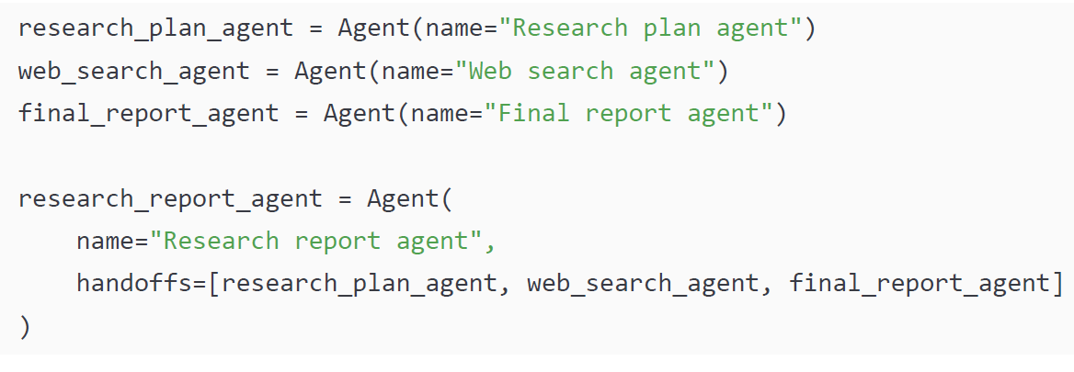
Handoff
This architecture can easily be created with this primitive in the following way:

Slide 26
Difference between an agent handoff versus a tool calling
Transfer of context: During a handoff, the SDK transfers the necessary context, such as the conversation history (instead of pre-defined rigid arguments), to the next agent, letting the work proceed without interruption.
Transfer of control: Handoffs put another “driver” in charge of the overall goal rather than “outsourcing” a particular sub-task. The agent that is “invoked” can call its own tools and then hand off to another agent as desired.

Slide 27
Guardrails
Definition: Guardrails act as safety mechanisms to validate user input and agent output.
Implementation:
Created like a tool, using a decorator on a Python function.
Triggered automatically based on custom logic defined by the developer.
Example:
Ensures a customer service agent only responds to relevant customer service queries, rejecting unrelated requests.
Purpose:
Maintains safety, relevance, and correctness in AI agent interactions.

Slide 28
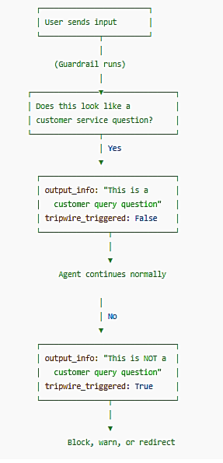
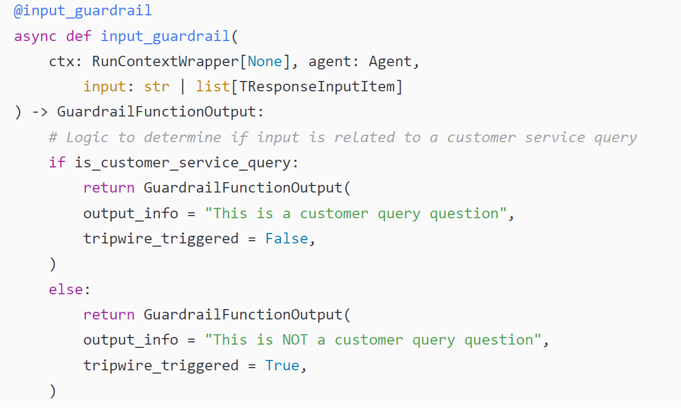
Guardrails
# The @input_guardrail decorator tells the SDK
# that this function will check incoming user input
# before the agent processes it.
# Execution context for the agent run

Slide 29
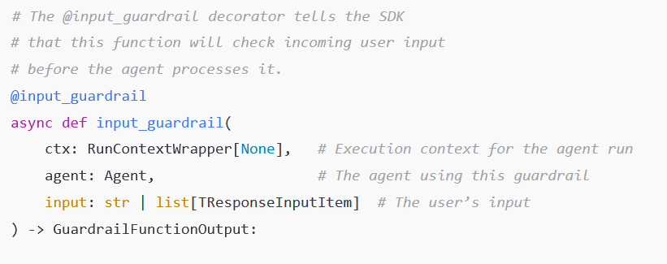
Guardrails

Slide 30
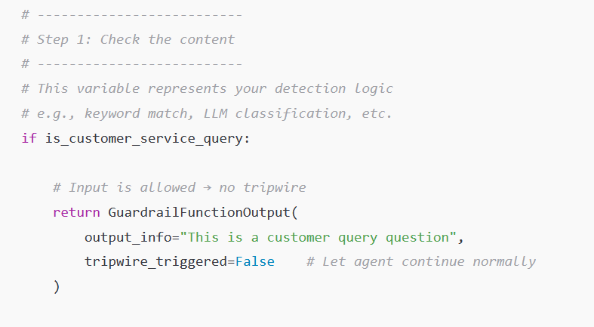
Guardrails

Slide 31
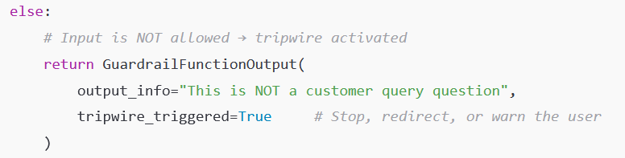
Guardrails

Slide 32
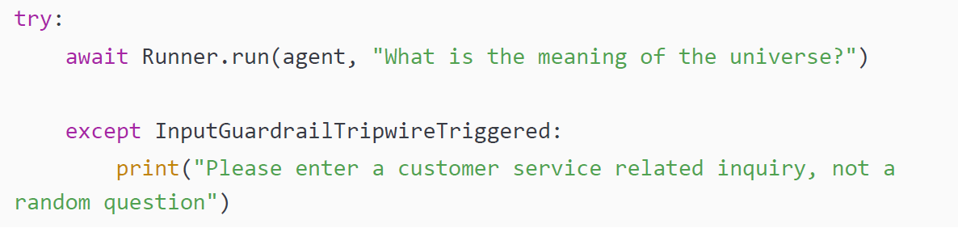
Guardrails
If the guardrail fails any validation, a “tripwire” is triggered, and a specific error type is raised in Python. This error can be handled in whatever way is desired.
For example, you may want the error to trigger a message to the user to let them know that this is not a valid use of the agent, or to purposely halt any further execution and return an error code.
Notes:
The concept of guardrails in AI agents is important yet barely discussed. For example, you may want to run the preceding guardrail as executing any agents or tools may be computationally or financially expensive. Any autonomous system that is not deterministic needs guardrails to ensure proper functioning, and this primitive makes it simple for developers to implement this mechanism.
Note
Guardrails usually take the form of decorated Python functions that embed the validation rules. These can be applied to either the initial input from the user or the output to the user. However, those functions can themselves call on another agent to inspect the candidate input or output and decide whether it meets the specified criteria. This means not only can you have agents as tools but also agents as guardrails.
Tracing
The tracing primitive allows developers to observe and debug the behavior of their agent systems by capturing and recording detailed execution flows during a run. Tracing acts like a flight data recorder for your agent’s reasoning loop. This includes every decision made by the agent, tool invocations, intermediate messages, and handoffs between agents. Without tracing, understanding how and why an agent came to a particular result can be extremely difficult, especially in complex or multi-agent workflows.
The SDK provides a built-in tracing utility that can be used manually, but more commonly, tracing is enabled automatically through the SDK’s integrated tracing system. This system can persist traces locally or send them to a remote tracing backend such as OpenAI’s built-in UI or your own custom observability setup.
Let’s look at a simple example. Imagine we want to debug the behavior of our customer service agent when it receives a user request:
From agents import Runner, enable_tracing
await Runner.run(agent, "Please cancel my last order.")

Slide 33
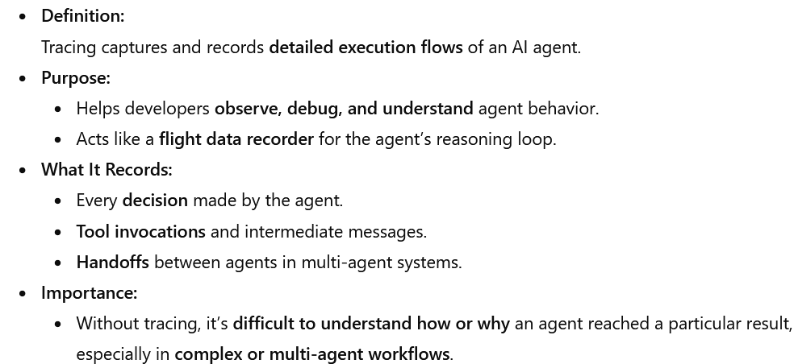
Tracing

Slide 34
Tracing
The SDK includes a built-in tracing utility for observing agent execution.
Tracing can be used manually or enabled automatically through the SDK.
Captured traces can be stored locally or sent to a remote backend.
Supported backends include OpenAI’s built-in UI or a custom observability setup.
Provides developers with flexible options for monitoring and debugging agent behaviour.

Slide 35
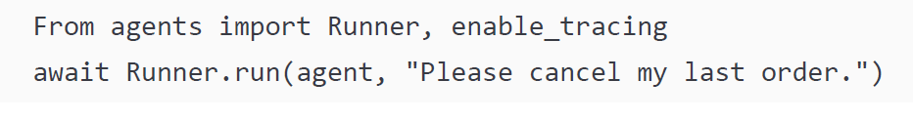
Tracing
Let’s look at a simple example. Imagine we want to debug the behavior of our customer service agent when it receives a user request:

Slide 36
Tracing
Once tracing is enabled, the SDK captures and logs the following:
The initial user input and system instructions
The model’s internal reasoning (thoughts)
Any tool calls made (with arguments and outputs)
Any handoffs triggered (with full context)
Final response returned to the user

Slide 37
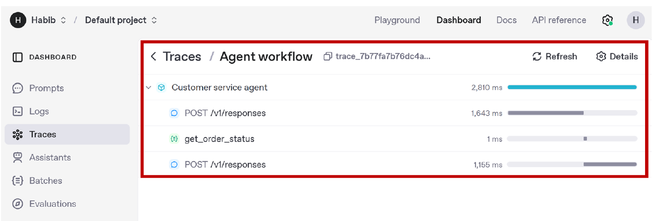
Notes:
Tracing is especially powerful when paired with guardrails. For example, when a guardrail tripwire is triggered, tracing allows you to capture exactly what input caused the issue and what steps were taken up to that point. This makes it much easier to tune your agents or validate business logic in sensitive applications.

Slide 38
Summary
In this chapter, we conducted a deep dive into OpenAI Agents SDK and what makes it special. We saw how its minimalist abstraction philosophy strips away boilerplate, letting plain Python do the talking, while still being powerful enough to create sophisticated AI agents and multi-agent solutions. We also saw how it was completely open sourced, inviting community scrutiny and enabling tons of extensions.

Slide 39
Summary
We then looked at the core primitives that make up the SDK. In particular, we focused on the following:
Agent: A thin wrapper that turns an LLM into an autonomous agent. It carries a name, system instructions, an optional tool belt, and a list of peer agents for potential handoffs.
Runner: The execution engine that drives an agent’s iterative reasoning loop, handles retries, and enforces safety limits to prevent infinite spins.
Tools: Ordinary Python functions (or hosted APIs/agents) decorated so the model can discover their purpose, construct valid arguments, and invoke them exactly when needed.
Handoffs: The orchestration mechanism that lets an agent delegate control (and the full conversational context) to another agent, enabling elegant multi-agent workflows.
Guardrails: Policy checks that wrap every step of the loop, ensuring outputs, tool calls, and handoffs stay within business and compliance boundaries.
Tracing: Automatic, structured logs of every prompt, response, and tool invocation—essential for debugging, observability, and post-mortem analysis.

Slide 40
